Slide 1
Brand Modernization
Notes:
NHQ has been working on brand modernization since early 2020 for reasons that will become clear in this deck. This presentation answers the question of why CAP needed to modernize the visual identity.

Slide 2
Brand Objective
As part of Civil Air Patrol’s effort to increase brand awareness and bolster recruiting efforts by turning our focus outward, underperforming and/or outdated marketing and brand strategies are being addressed.
Modernizing the visual identity (primarily the logo) was an important brand management step that reflects the persona of a dynamic organization.
Notes:
CAP spends considerable effort talking to ourselves about ourselves. That’s important in a member-driven organization, but it is not a growth strategy. CAP needs to increase brand awareness to stimulate recruiting efforts. To do so, the brand’s visual identity needed to come into the 21st century to be more relevant, exciting, and positioned as a Total Force partner.

Slide 3
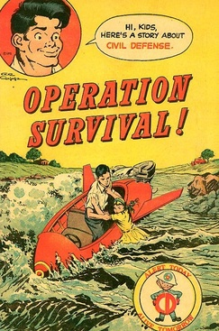
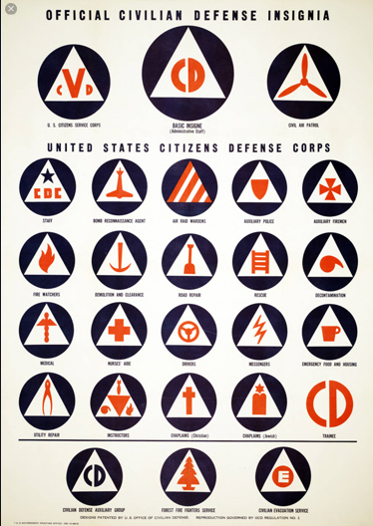
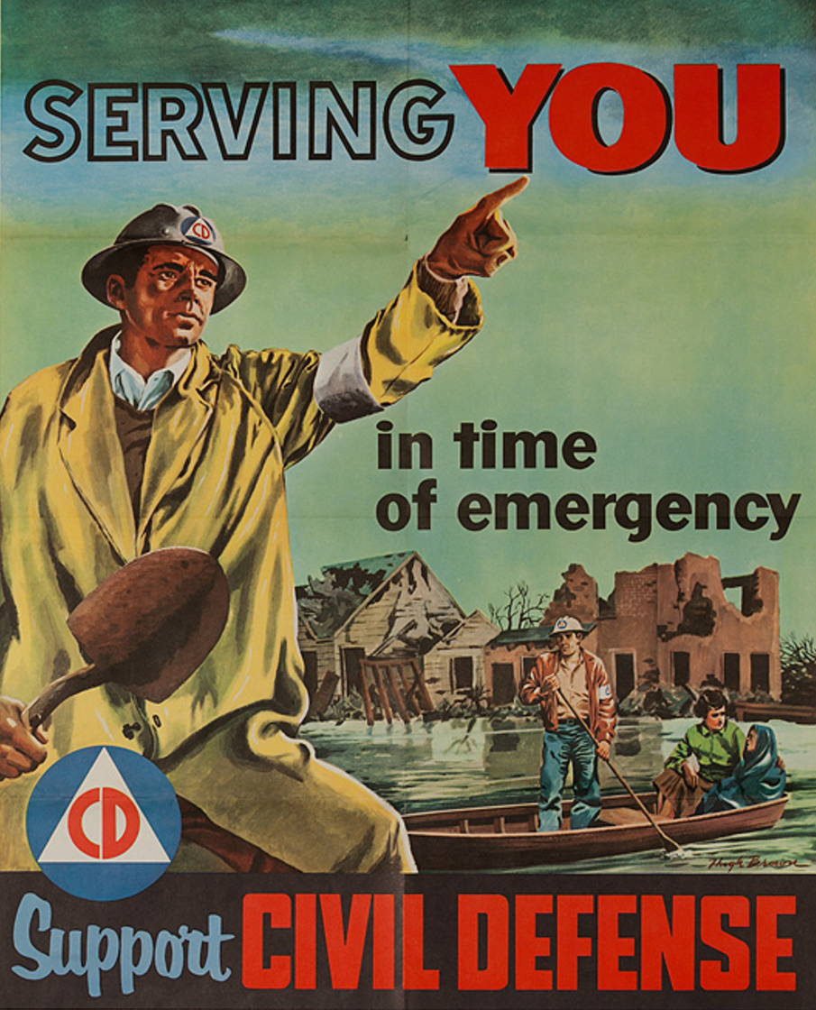
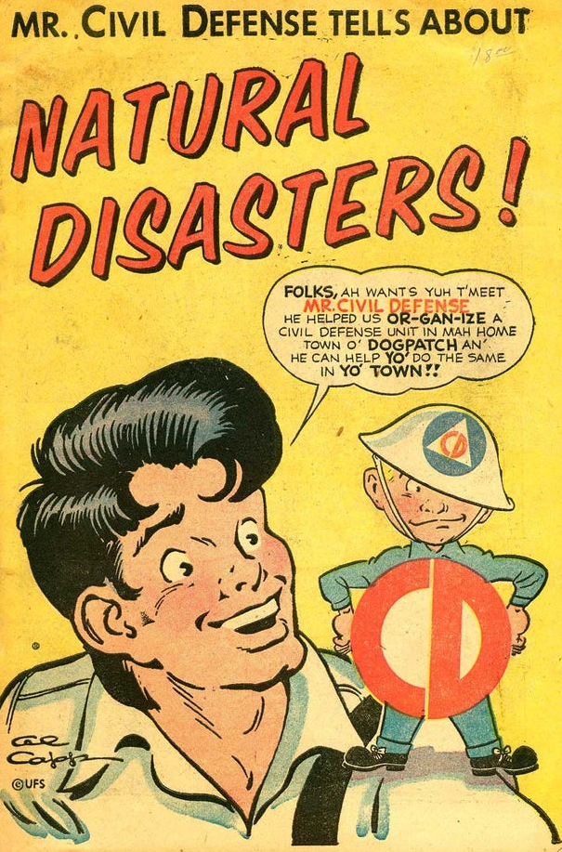
Current State
Civil Air Patrol’s bold new Mission Statement and comprehensive Strategic Plan were married to a mid-20th century visual identity.
That brand disconnect linked Civil Air Patrol to something that hasn't existed since the Truman Administration – the Office of Civilian Defense.
Notes:
CAP has dramatically improved the level of sophistication and effectiveness in Strategic Planning, Philanthropy, Innovation, Safety, Operations, Enterprise Risk Management, Marketing and Strategic Communications and more just in the past few years. The 80-year-old visual identity did not accurately reflect the dynamic and well-managed company that is today’s CAP.

Slide 4
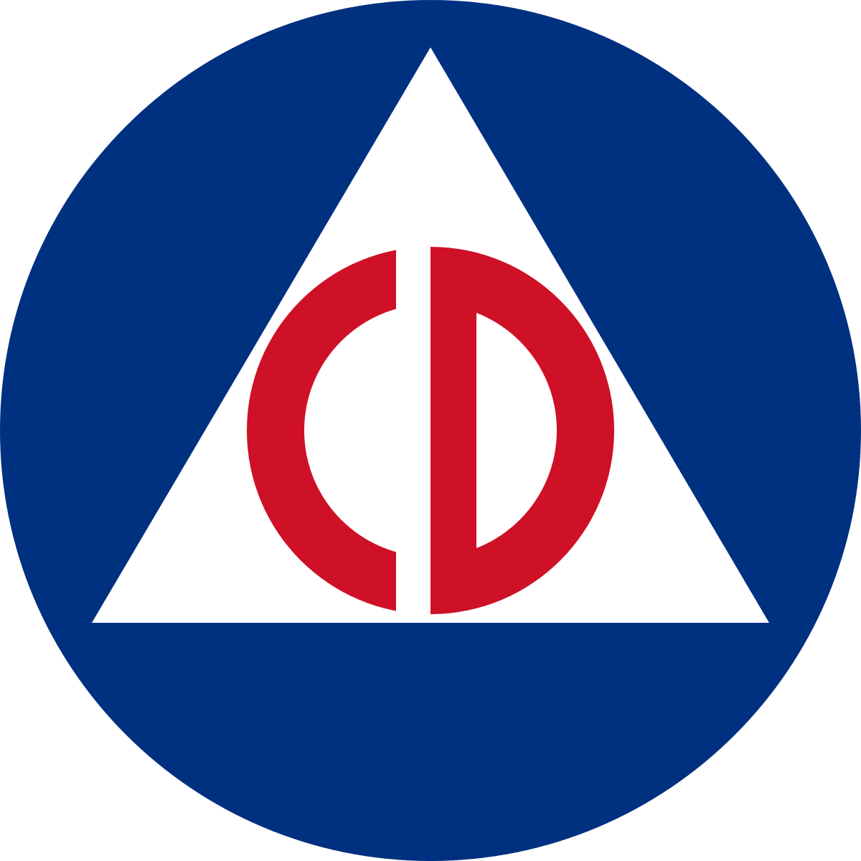

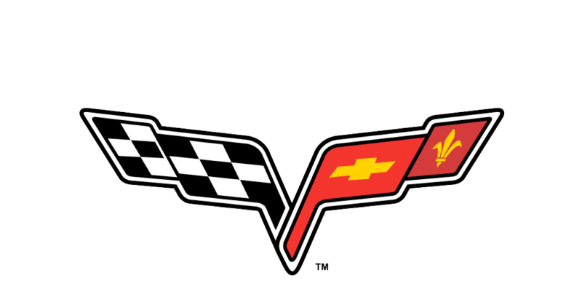


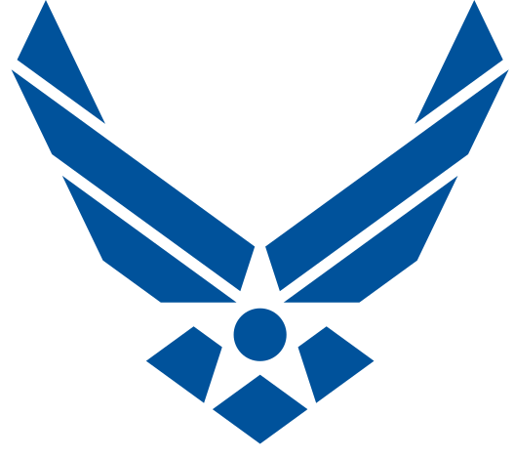
The Journey to Modernization
01
02
03
04
05
06
Current State:
Best Practice:
Rationale:
Readiness:
Case Studies:
Next Steps:
How we got here
Why brands modernize
Why CAP needs a refresh
What members think
How other companies manage
Where we go from here
Notes:
This deck is a subset of what NHQ used for almost two years with focus groups, at wing conferences, and national conference roundtables to discuss the need to modernize CAP’s visual identity.

Slide 5
How We Got Here
01
Understanding Civil Air Patrol’s Civilian Defense identity guided the brand strategy forward.
Current State:

Slide 6
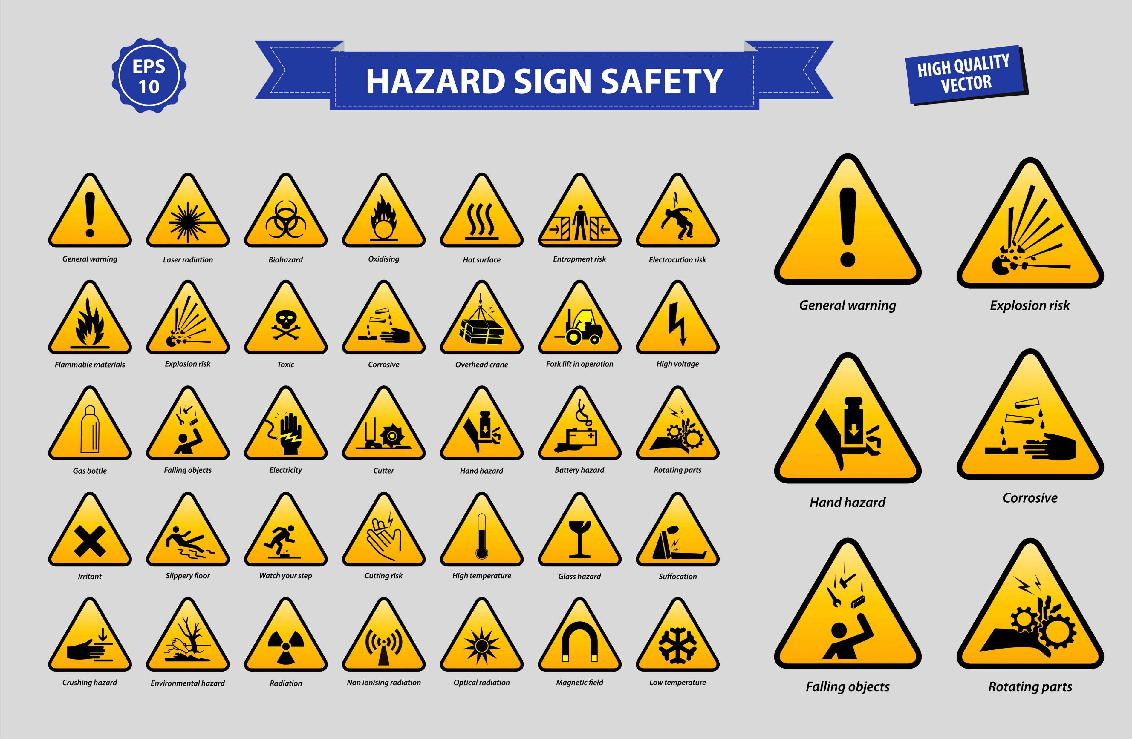
Origin of the CAP Identity
The Triblade symbol is based on the 1940s suite of now-obsolete Civilian Defense iconography.
The Civil Air Patrol symbol was not developed as a meaningful brand identity; it was merely an icon for quick reference.
None of these icons are logos
Notes:
CAP’s Civilian Defense symbol became the organization’s visual identity by default – it was not developed as a thoughtfully designed corporate logo any more than a safety sign would be considered a corporate logo.

Slide 7

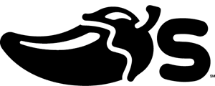
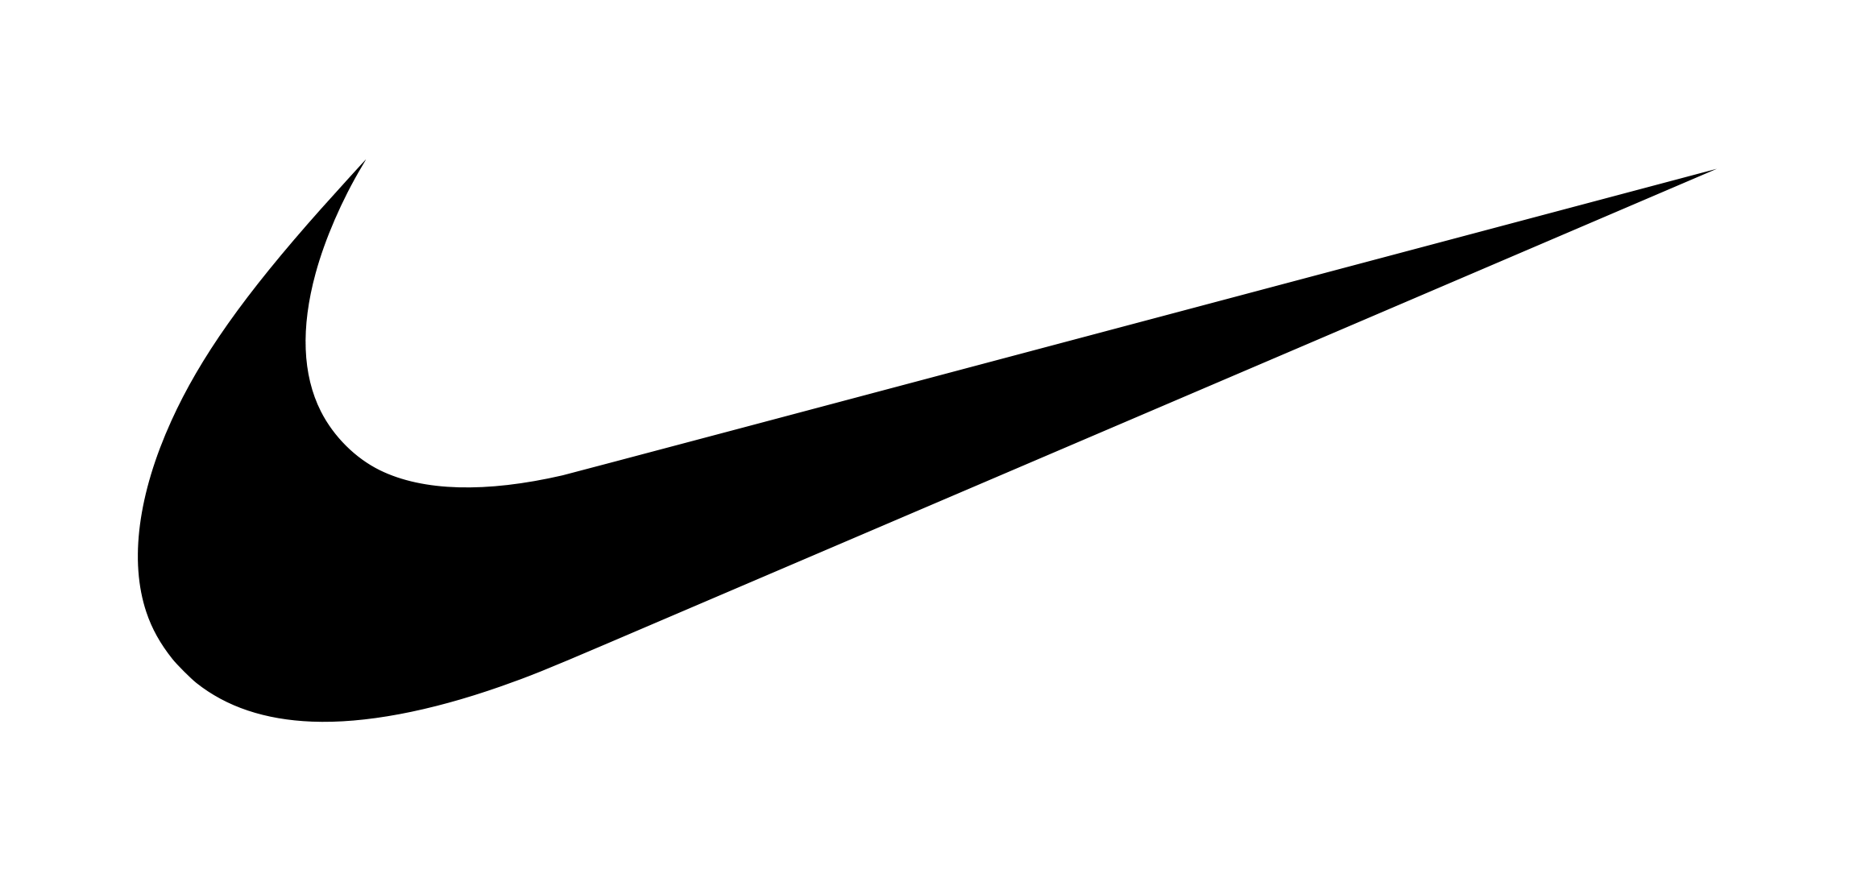






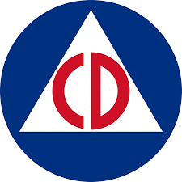
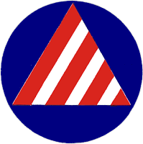



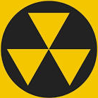
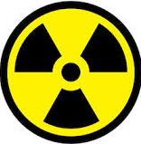



Icons vs. Logos
Logos tell a brand story.
Logos are unique shapes designed to capture the essence of a company or product in a thoughtful way.
Icons are intended to simplify and communicate a message at a glance.
Notes:
A logo should tell a brand story. The new logo does exactly that.

Slide 8



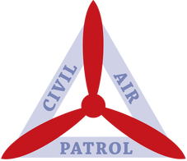
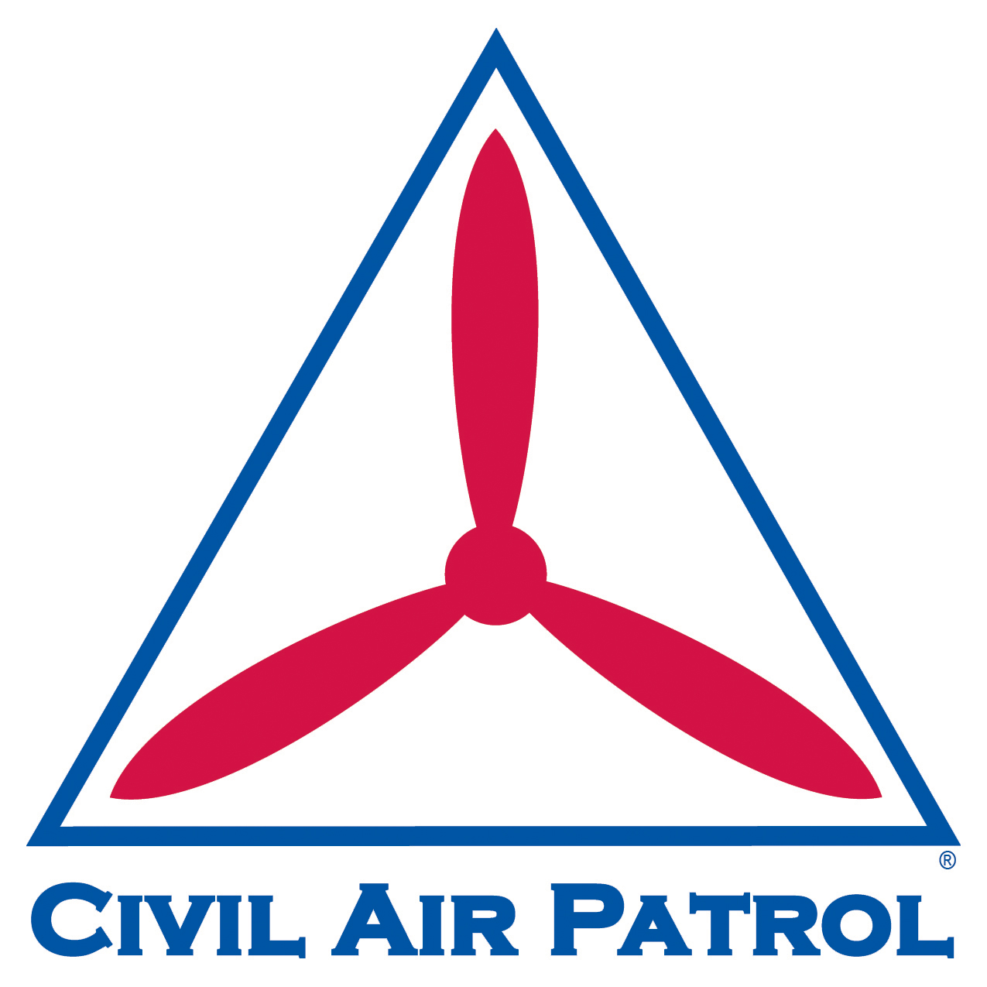
Visual Identity Timeline
1941-1952
1951-1966
1959-2012
2011-2012
2012- today
2019 - today
1
2
3
4
5
6
Efforts to refresh the symbol over a span of 80 years did not fully capture the essence of an evolving organization — especially when the symbol is uncoupled from the wordmark.
Notes:
Except for a shoulder patch from 1951-1966 and a short-lived symbol variant in 2011-2012, CAP hasn’t effectively shed the 1940s Civilian Defense identity despite the fact that Civilian Defense hasn’t existed in decades.

Slide 9
01
02
03
04
05
06
Current State:
Best Practice:
Rationale:
Readiness:
Case Studies:
Next Steps:
How we got here
Why brands modernize
Why CAP needs a refresh
What members think
How other companies manage
Where we go from here

Slide 10
Why Brands Modernize
02
Brands modernize because change is constant.
Missions change, technology advances, products and services evolve, and design trends shift.
Visual identities that stagnate give the impression that the company, product, or service is outmoded.
Modernizing a logo is a visual manifestation that reflects change.
Best Practice:
Notes:
Powerful brands change with the world around them. For example, AT&T is no longer known as American Telephone & Telegraph and their logo is no longer an antique telephone. The modernized name and stylized logo represent a much more modern, global company.

Slide 11
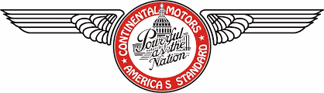
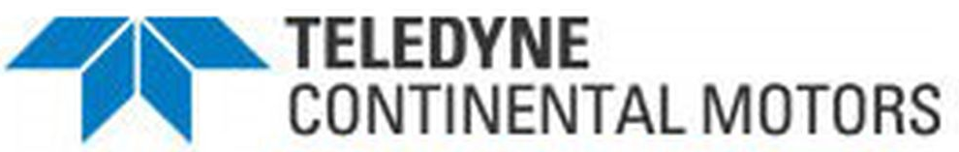

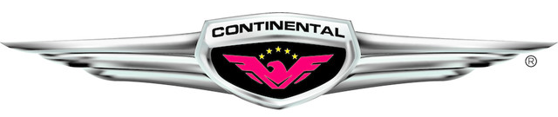
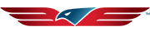
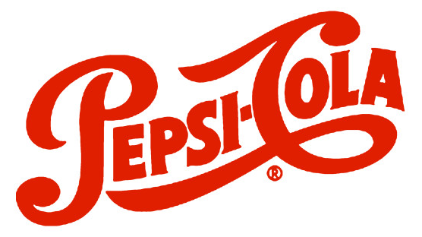
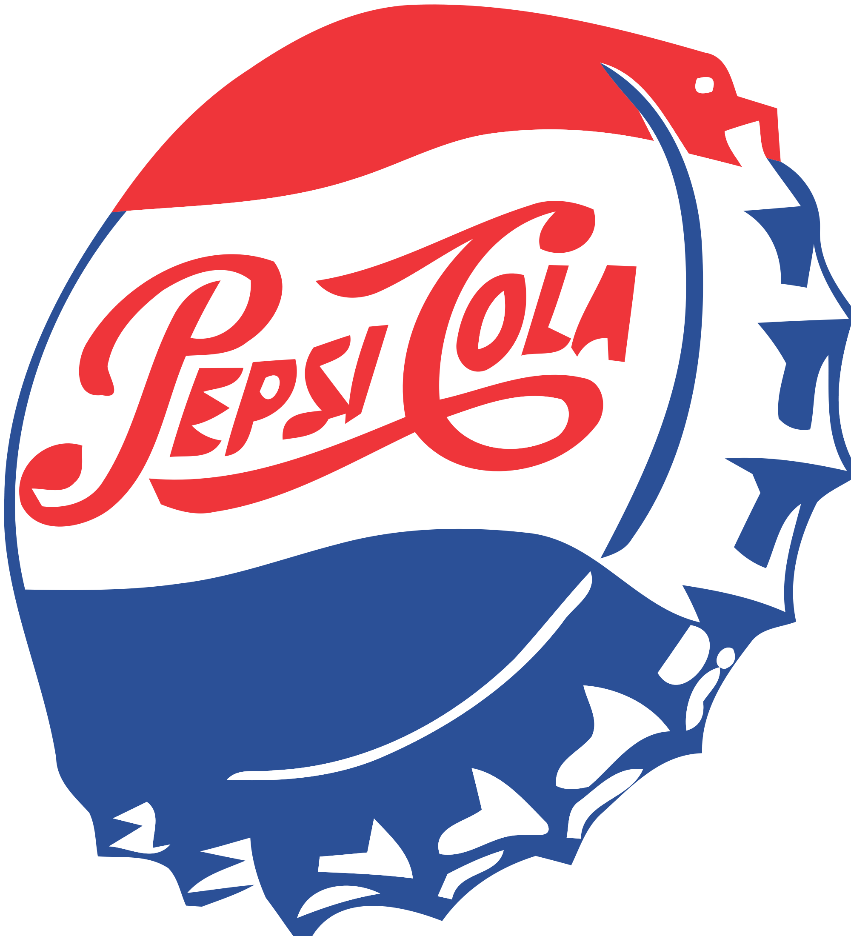
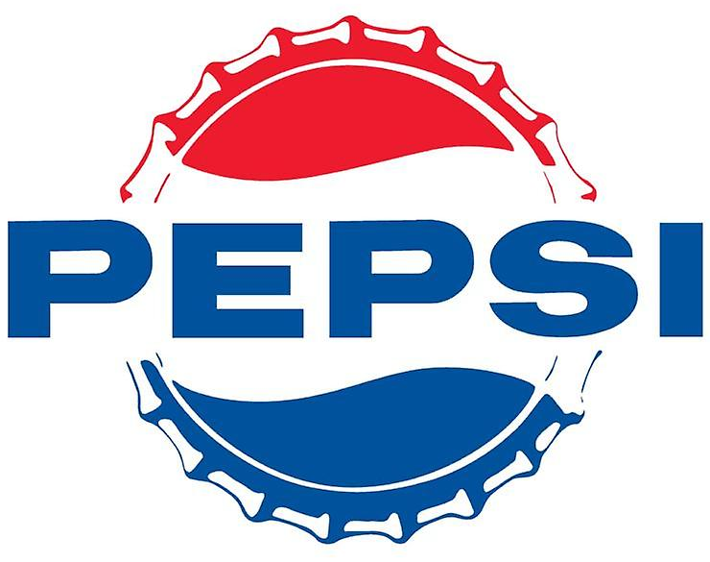
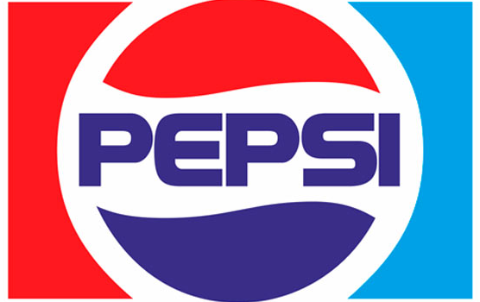
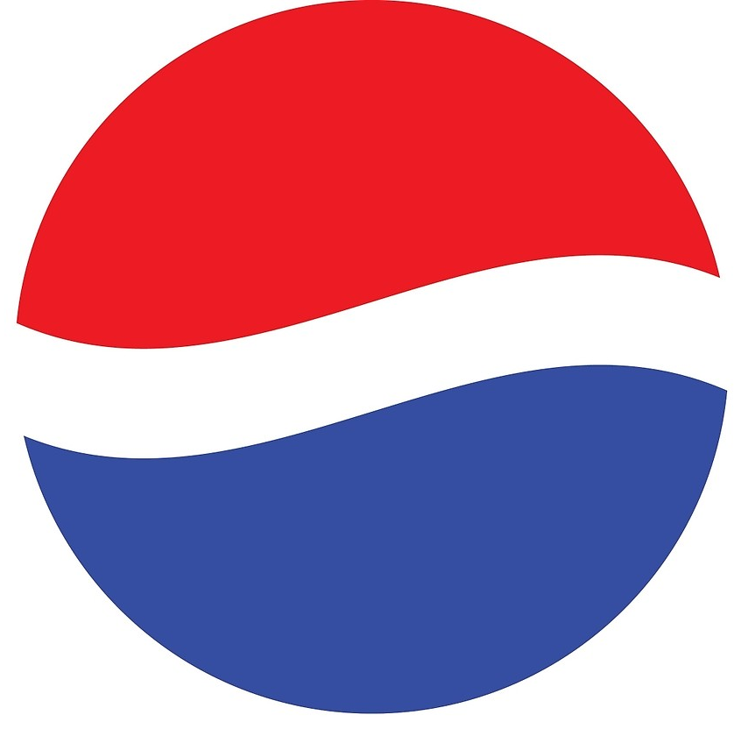

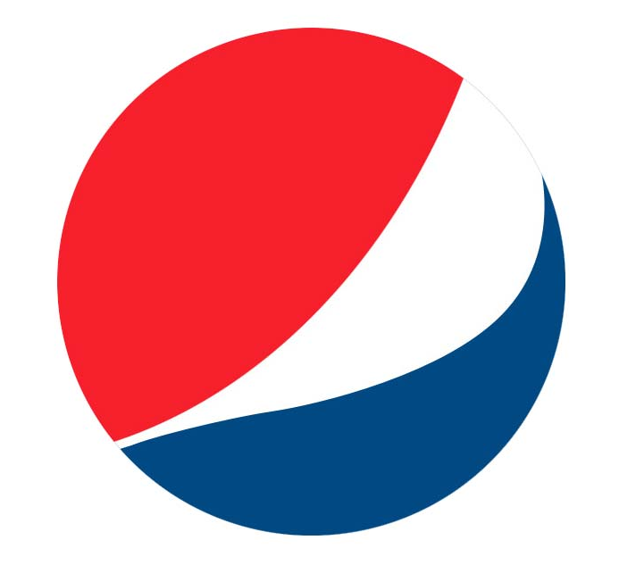
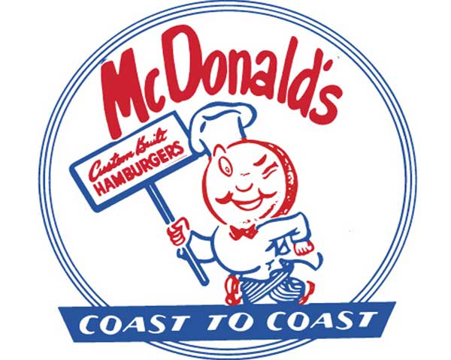








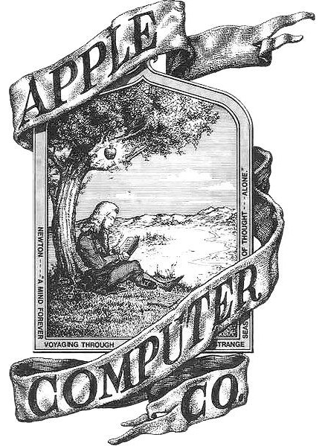









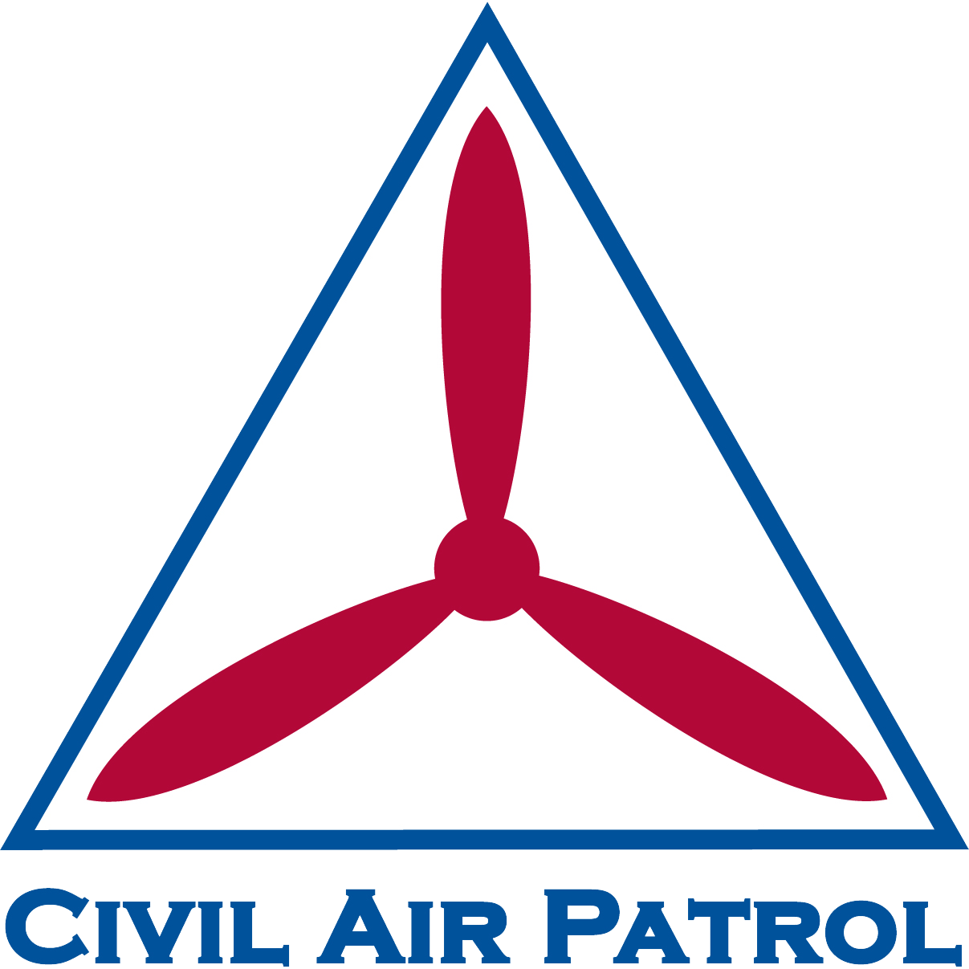
Sample Brand Modernization
Continuous modernization
1940s 1950s 1960s 1970s 1980s 1990s 2000s 2010s 2020s
Indicates year of most recent brand refresh
Updating a logo periodically is a brand management best practice that exhibits progress.
Prolonged period of stagnation
Prolonged period of stagnation
Notes:
The hallmark of good brand management is to grow, change, and evolve to remain relevant, generation after generation.
A symbol associated with a WWII-era organization loses relevance with each new generation of youth.

Slide 12
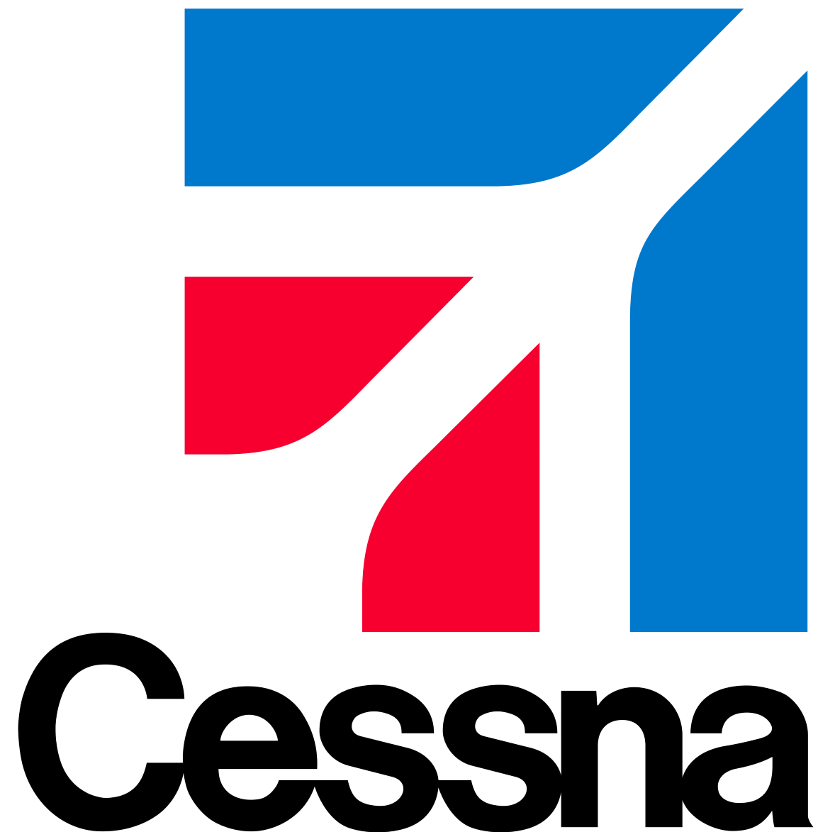
Changing Times
Brands that don’t evolve lose relevance.
For example, the vintage Cessna logo (left) was appropriate branding on the tail of a circa-1940s Cessna 195. But that same logo would create a brand disconnect in 2022 if seen on the tail of a swept-wing .935 Mach-capable Citation X business jet.
Circa 1947
2022
Notes:
Cessna no longer produces radial engine tail-dragging aircraft and consequently, the company logo has evolved multiple times over the decades. Today’s Cessna logo represents an aspirational swept wing aircraft made in America.

Slide 13

Remaining Relevant
Brands that don’t evolve, lose relevance.
In 2000, the Air Force updated its logo. The new shape reflects a modern air force more than a bygone age of Army aviation.
Circa 1940
Today
Without Civilian Defense, the CAP logo has lost its point of reference. Consequently, each new generation of cadet is further removed from the relevance of a WWII-era visual identity.
Notes:
Understanding brand psychology and the physiology of how humans absorb information visually and make subconscious assessments, CAP needs to modernize the symbol. We’re not our grandmothers’ CAP anymore.

Slide 14
01
02
03
04
05
06
Current State:
Best Practice:
Rationale:
Readiness:
Case Studies:
Next Steps:
How we got here
Why brands modernize
Why CAP needs a refresh
What members think
How other companies managed
Where we go from here

Slide 15
Why CAP Needs a Refresh
03
In order to promote Civil Air Patrol as a high-tech company that adapts, adopts, and develops technology, the visual identity needs to migrate to the 21st century to match the technology the organization uses.
Rationale:

Slide 16
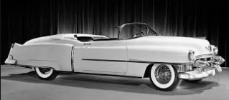
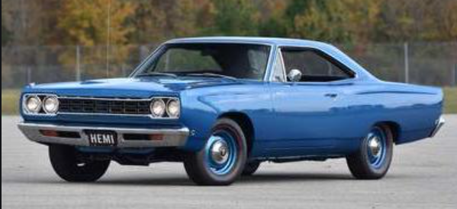
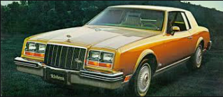

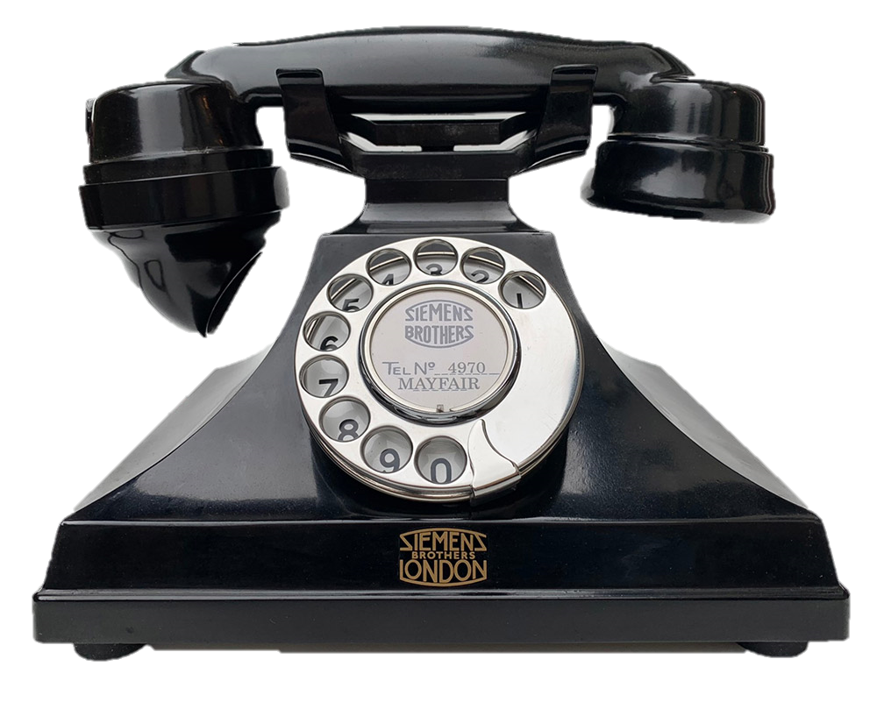


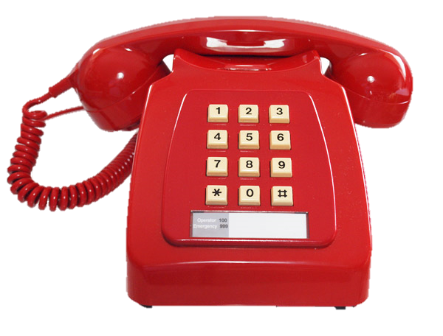
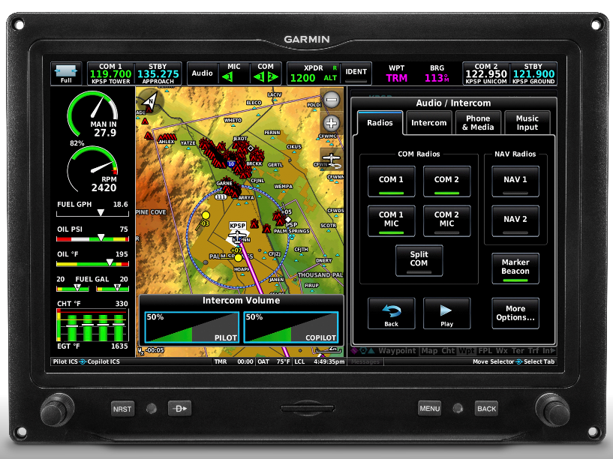
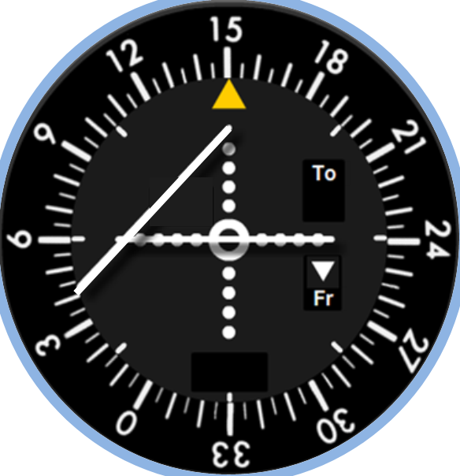
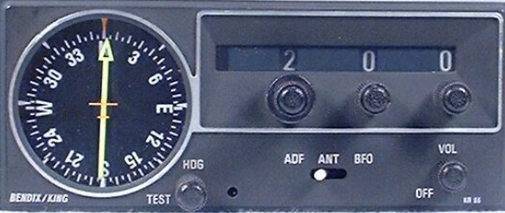
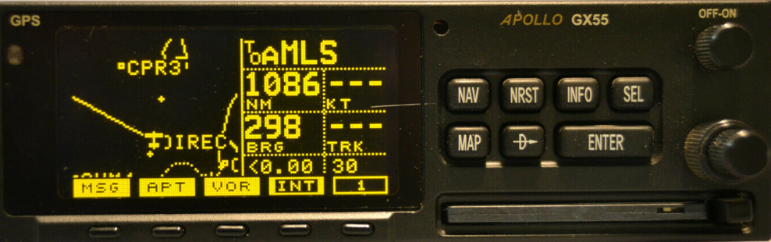


Eight Decades of Modernization
Modernization
1941-1959
1960-1979
1980-1999
2000-2020
Cruiser
Muscle
Luxury
Electric
Mobile
Rotary
Touchtone
Cordless
MFD
ADF
VOR
GPS
Stagnation
Notes:
The world has changed considerably in 80 years, but CAP’s visual identity hadn’t changed noticeably since the 1940s Civilian Defense era.
By default, the CAP symbol was subconsciously telling the nation, donors, stakeholders, prospective new members, etc. that we’re the same organization we were in the days of Civilian Defense.

Slide 17
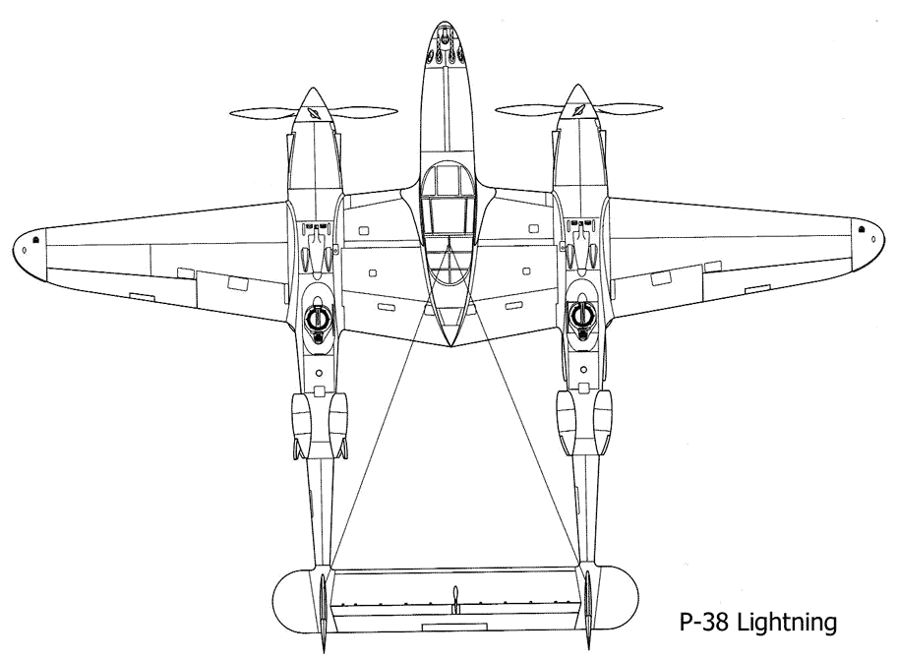
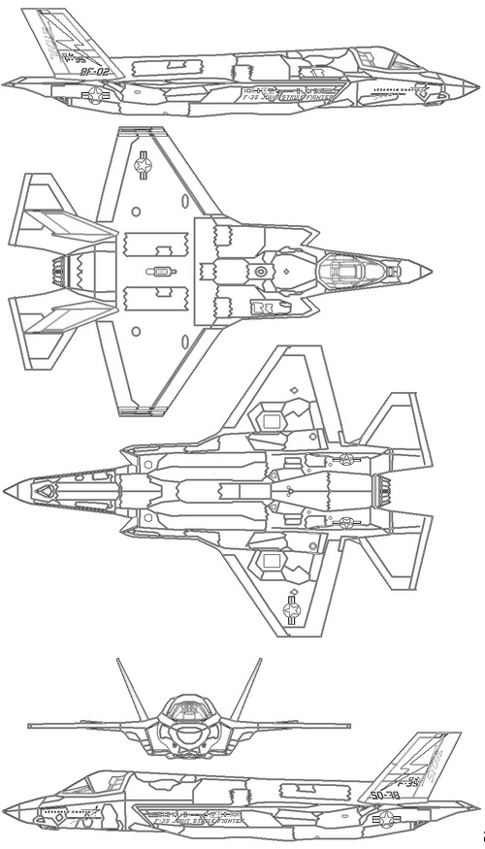
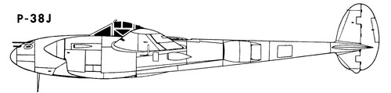
AF Modernization Example
Air Force logo reflects the current technology.
P-38 Lightning Circa 1940s
F-35 Lightning II
Circa 2020s
Top Speed: 443
Top Speed: 1,199
Notes:
The new USAF logo reflects the evolution of technology – even its stealthy shape is sleek and fast.

Slide 18
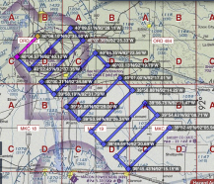
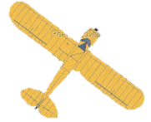
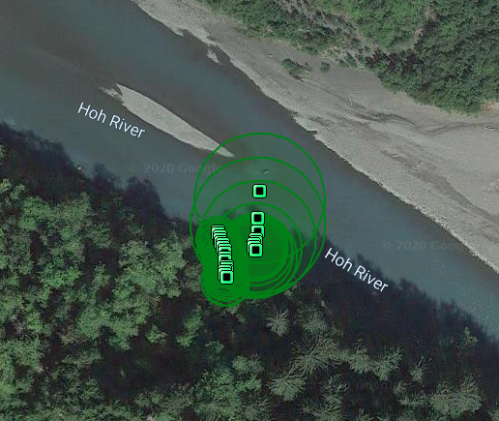
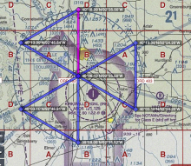
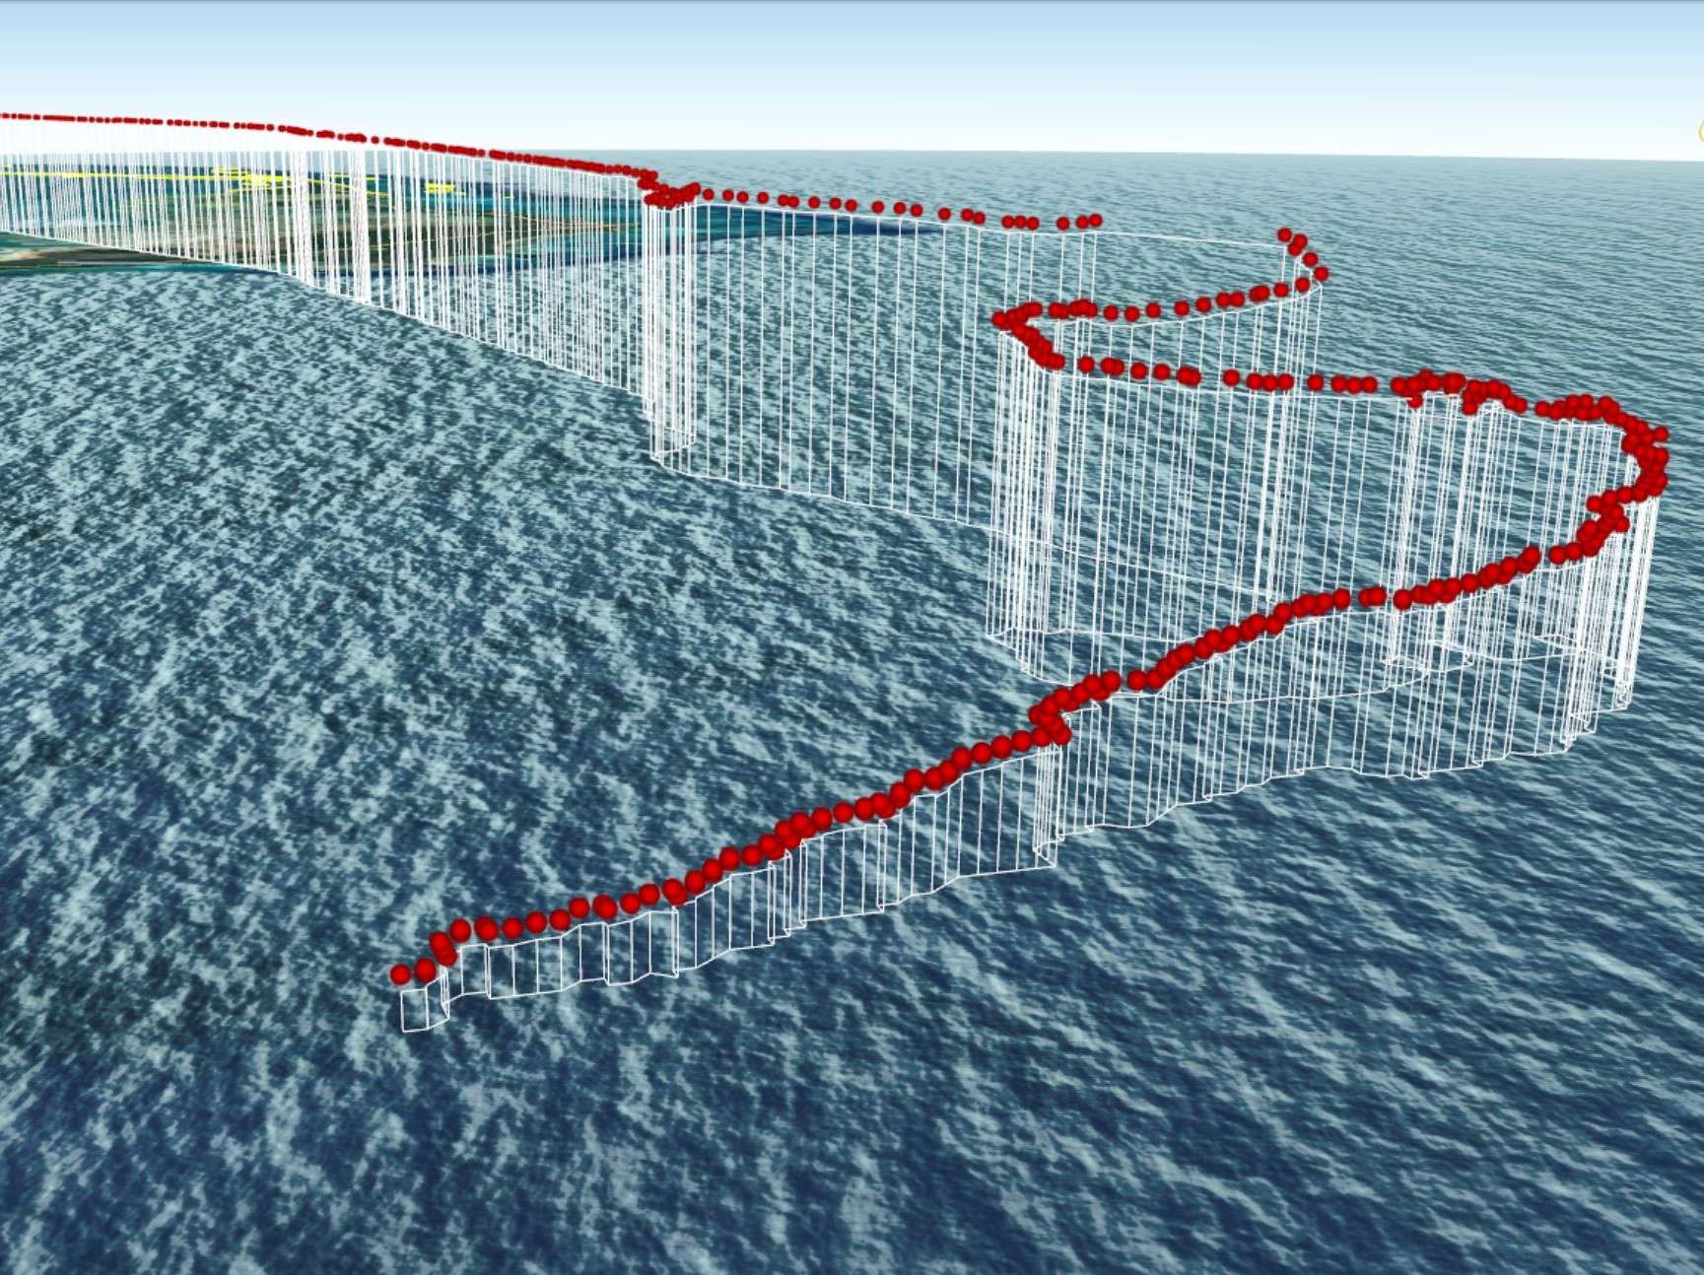
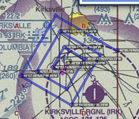
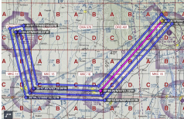

CAP Modernization Example
CAP symbol did not reflect current technology.
20th Century Search Techniques:
Expanding Square
Contour Search
Sector Search
Parallel Track
Route Search
Creeping Line
21st Century Search Techniques:
Cellphone Forensics
Radar Analysis
GPS Coordinates:
LAT: N 25-43
LON: W 76-38
Search Time:
Measured in Hours
Search Time:
Measured in Minutes
Notes:
The CAP Civilian Defense symbol did not reflect the quantum leap in technology since the 1940s.

Slide 19
01
02
03
04
05
06
Current State:
Best Practice:
Rationale:
Readiness:
Case Studies:
Next Steps:
How we got here
Why brands modernize
Why CAP needs a refresh
What members think
How other companies managed
Where we go from here

Slide 20
What Members Think
04
Since first mentioned at the 2020 Winter Command Council, a brand refresh has been discussed among various groups of members large and small.
Various formal and informal polls validated the readiness of members to modernize the visual identity.
Readiness:

Slide 21
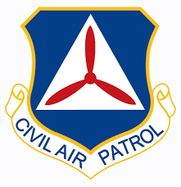


Survey Results
Beginning in mid-2020, members were surveyed and polled at multiple focus groups, wing conferences, and presentations about the idea of modernizing the brand.
54%
14%
“It's time to refresh the logo to something more modern like the Air Force.”
“I like the current logo.”
“The vintage look keeps us connected with our 1940s Civil Defense heritage.”
81% WANTED CHANGE
27%
5%
“I'd like to see a bold new logo.”
“CAP is very different today and our logo should reflect that.”
“I'm not certain which one of the CAP graphics is the official logo.”
Notes:
The data shown is a compilation of all surveys and polls over the past two years.

Slide 22
01
02
03
04
05
06
Current State:
Best Practice:
Rationale:
Readiness:
Case Studies:
Next Steps:
How we got here
Why brands modernize
Why CAP needs a refresh
What members think
How other companies manage
Where we go from here

Slide 23
How Companies Manage
05
Brand modernization occurs on a continuum from gradual evolution to a complete redesign.
Whether the CAP visual identity changed or not, it would still be making a statement – intentional or not.
The objective is to align a logo with the desired reaction, not the default perception.
Case Studies:

Slide 24



Refresh Continuum
Subtle logo changes that evolve organically (but more frequently) convey consistency – a quality that consumers desire in specific products and services categories like food service.
The McDonald’s logo has changed more than 20 times since 1940. Most have been very subtle, organic alterations.
Dramatic logo redesigns reflect boldness, innovation, and change – qualities that consumers demand in specific categories like technology.
American Telephone & Telegraph is now AT&T Wireless. The logo (and name) reflect significant advancements in company evolution.
Notes:
Over the decades, CAP has created, adapted, and adopted technology to be a more efficient, productive, and successful organization – for example, cell forensics replaced airborne daylight search and GPS replaced the whiskey compass.
Since the CAP visual identity hasn’t kept pace with change for the past 80 years, any logo refresh that attempts to make up for 80 years of stagnation may seem dramatic to some (more a revolution than an evolution). CAP’s identity has some catching up to do with what the Air Force did 20 years ago.

Slide 25
USAF Case Study
The Air Force identity is a modernized representation of a 21st century air force advancing into the future.
Circa 1940
Today
The Civil Air Patrol identity remains visually linked to Civilian Defense of the 20th century – grounded in the past when we should be looking to the future as a Total Force partner.
Notes:
Realizing the psychology of branding and the physiology of how humans absorb information visually and make subconscious assessments, the Air Force modernized the logo at the turn of the century – more than 20 years ago.
By comparison, the visually antiquated CAP Triblade symbol makes the company feel dated compared to the Air Force. Even updating the red propeller to a more modern simitar-shaped prop would have been a step into the 21st century decades ago.

Slide 26


Air Force Rebrand Scorecard
Retains heritage (star and globe)
Simplified design (one color)
Increased flexibility (no container)
More modern than retro
Enhanced visual appeal
Modern design aesthetic
More closely represents today’s organization than yesterday

Slide 27

The Question Is:
Should CAP remain connected to the WWII past?
Should CAP be better positioned
for the future?
OR
1941 -- 2022
2000 2022 -
Civilian Defense Symbol
Civil Air Patrol Symbol
U.S. Air Force Logo
CAP/Air Force Auxiliary Logo
Office of Civilian Defense dissolved in 1945
Total Force partnership
established 2015

Slide 28
01
02
03
04
05
06
Current State:
Best Practice:
Rationale:
Readiness:
Case Studies:
Next Steps:
How we got here
Why brands modernize
Why CAP needs a refresh
What members think
How other companies manage
Where we go from here

Slide 29
Where We Go From Here
06
Modernization objectives:
Update the logo to reflect a dynamic 21st century company.
Improve visual appeal and flexibility.
Shape the desired perception rather than settle for the default assumption of CAP.
Retain part of CAP’s heritage.
Next Steps:
Notes:
Here’s what the brand modernization project set out to accomplish:

Slide 30







This is the family Civil Air Patrol should fit into.

Slide 31




Concept Inspiration
Volunteers serving America’s communities, saving lives, and shaping futures.
31
Notes:
In focus group comments, members asked for a logo more closely aligned with the Air Force. Inspiration for the new logo shape came from a combination of the Air Force logo and familiar CAP shapes.
While there are other nonprofits supporting emergency services, humanitarian relief, education/STEM, and youth programs, one thing that differentiates CAP is the fact that we operate the world’s largest fleet of aircraft. Aviation also provided a source of inspiration.

Slide 32




Logo Brand Story
1
Aviation
2
Volunteerism
Aviation differentiates CAP from other nonprofits in youth development, emergency services, and education.
Volunteerism fuels CAP, which is why “Volunteers” is the first word in the mission statement.
3
Partnership
Color and aesthetic cues visually align CAP as a Total Force partner of today’s modern Air Force.
5
Programs
4
Heritage
Bars divide the wing shape into thirds to represent three CAP programs.
Triangle and bars in the negative space celebrate the heritage of CAP’s Civilian Defense roots.
Notes:
A logo tells a brand story – here is Civil Air Patrol’s brand story shaped into a logo.

Slide 33





Logo Enhancements
Modern, single-color design comparable to USAF
Floats without a container for more flexibility
Lock-up is more purposeful
While not the same character size, both names have equal length
Wordmark is all caps like the six branches of the military

Slide 34


Logo Solutions
Better balance and purpose
A
A
Better parity between CAP and USAFX
Notes:
Updating the logo also provided an opportunity to solve some problem areas with existing logo variants.

Slide 35


What Members Say the Visual Identity Conveys
Notes:
These word clouds are a compilation of comments collected from member surveys and focus groups.

Slide 36
Concept Execution
Volunteers serving America’s communities, saving lives, and shaping futures.
36
Notes:
In focus group comments, members asked for a logo more closely aligned with the Air Force. Inspiration for the new logo shape came from a combination of the Air Force logo and familiar CAP shapes.
While there are other nonprofits supporting emergency services, humanitarian relief, education/STEM, and youth programs, one thing that differentiates CAP is the fact that we operate the world’s largest fleet of aircraft. Aviation also provided a source of inspiration.

Slide 37
CAP Rebrand Scorecard
Retains heritage (Civilian Defense triangle)
Simplified design (single color vs. three)
Increased flexibility (no container)
More modern than retro
Enhanced visual appeal
Modern design aesthetic
More closely represents today’s organization than yesterday’s

Slide 39





Air Force-Related Logo Family
Total Force
Civilian

Slide 40

Total Force Alignment
Volunteers serving America’s communities, saving lives, and shaping futures.
40

Slide 41



The Result
Seal
Unchanged
Emblem
Unchanged
Symbol
Updated
Notes:
Only the corporate symbol (logo) changes. The Command Emblem and Seal remain unchanged and will continue to be used in their specific applications. There is no change or impact to uniforms, vehicle graphics, aircraft livery, or heraldry.

Slide 42


END

